Slide 1
PICTURE DESCRIPTION
Career Development Cell
Parul Institute of Technology
Parul University

Slide 2
Picture Description in English
A visual representation of something such as a person or a scene, produced on a surface or as in a photograph, painting etc. Describing picture or other art pictures (e. g. caricatures) is something for the advanced learner of English as you also have to talk about the artists intention and the impression on the viewer.

Slide 3
1. Introduction
The photo/picture shows ...
It was taken by/in ...
It's a black-and-white/colour photo.

Slide 4
2. What is where?
In the foreground/background you can see ...
In the foreground/background there is ...
In the middle/centre there are ...
At the top/At the bottom there is ...
On the left/right there are ...
Behind/In front of ... you can see ...
Between ... there is ...

Slide 5
3. Who is doing what?
Here you decribe the persons in the picture or you say what is happening just now. Use the Present Progressive tense.

Slide 6
4. What I think about the picture
It seems as if ...
The lady seems to ...
Maybe ...
I think ...
... might be a symbol of ...
The atmosphere is peaceful/depressing ...
I (don't) like the picture because ...
It makes me think of ...

Slide 7
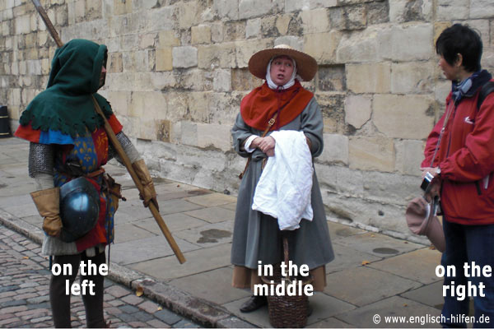

Slide 8
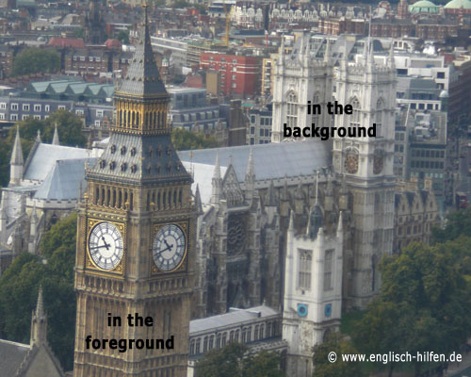

Slide 9
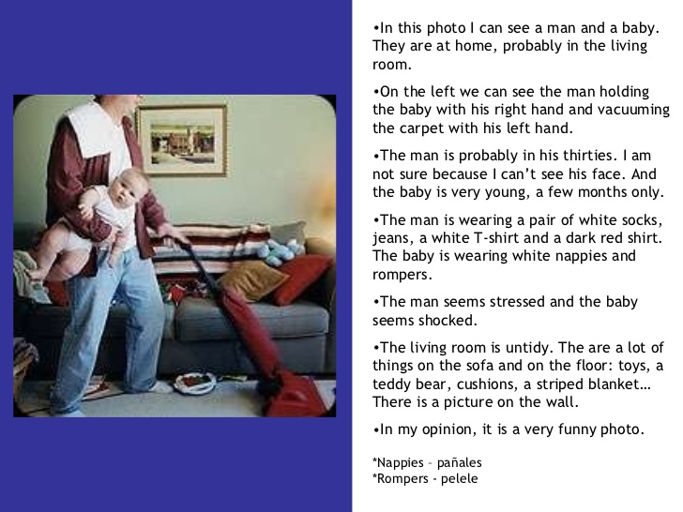

Slide 10


Slide 11
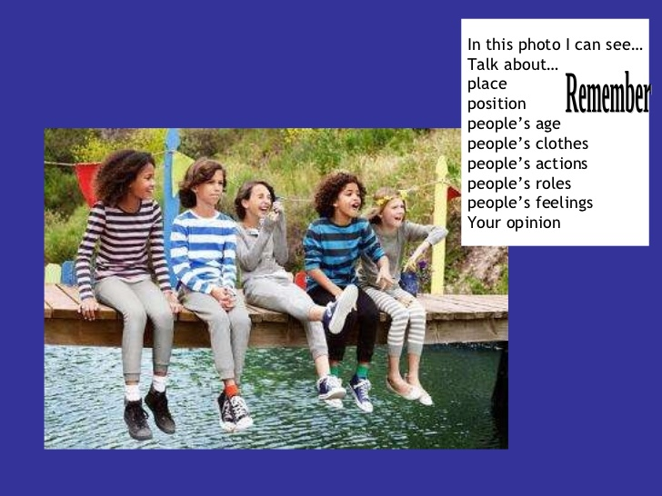

Slide 12


Slide 13


